Slide 1
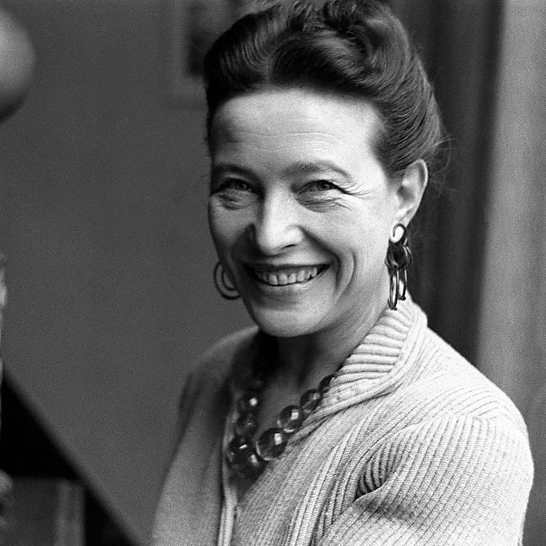

Simon de Beauvoir
‘We Define Ourselves Through Our Choices and Relationships’

Slide 2

Biography:

Slide 3
Key Ideas:
Every person has the freedom to make choices, and these choices shape their identity and destiny.
Life is filled with uncertainty. By navigating this uncertainty and making choices that individuals define their essence and purpose.
Our interactions with others, whether in friendship, love, or conflict, offer reflections of our own self and beliefs.
Living authentically means making choices that align with our true self, rather than conforming to external pressures or societal norms.
De Beauvoir argues that women's identities have been historically shaped by societal norms and expectations. She argues that women, like men, should be free to define themselves beyond societal roles.

Slide 4


Slide 5


Slide 6


